Slide 1
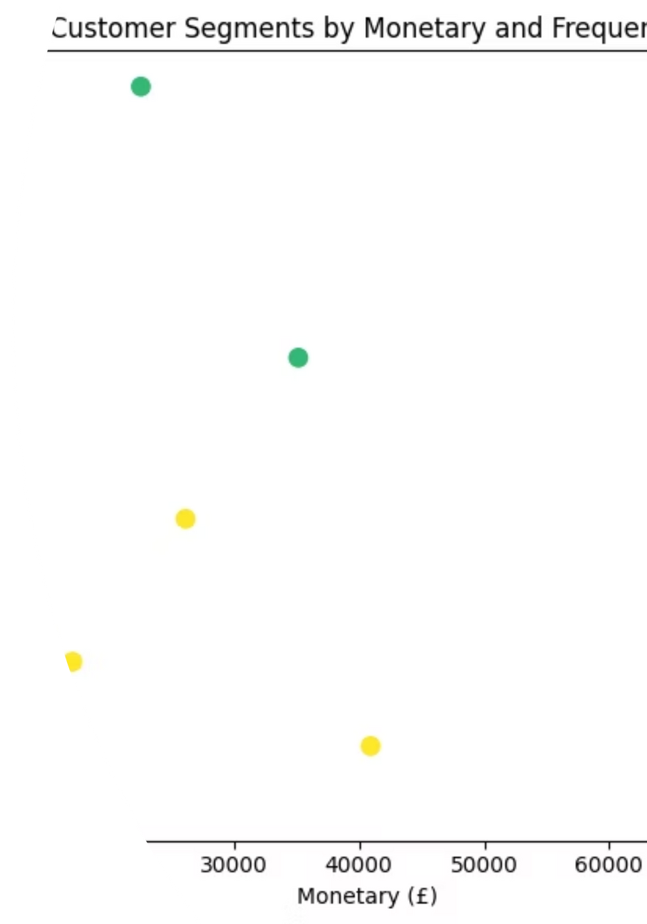

Customer Segmentation and Churn Prediction
Using RFM & K-Means for Enhanced Customer Insights
Presented by Ishimwe Honore for the Introduction to Big Data Analytics course at Adventist University of Central Africa on August 4, 2025.
Notes:
1

Slide 2

The Challenge: Identifying Customer Value & Retention Risks
Businesses often struggle to differentiate between loyal and inactive customers.
A lack of data-driven strategies leads to ineffective targeting and significant revenue loss.
Our goal: Implement RFM and K-Means clustering to segment customers and accurately predict churn behavior.
Notes:
2

Slide 3
Dataset Foundation: Online Retail Transactions
Source: Online Retail Dataset from UCI Machine Learning Repository.
Key Columns:
InvoiceDate: Timestamp of each transaction.
Scope: Contains transactional data from a UK-based online retailer.
Period: Covers sales activities between December 1, 2010, and December 9, 2011.
Quantity: Number of items purchased.
UnitPrice: Cost per item.
Volume: Approximately 500,000 rows of transaction records, structured across 8 columns.
CustomerID: Unique identifier for each customer.
Country: Origin of the customer.
Notes:
3

Slide 4
Data Refinement: Ensuring Data Quality
Filtering Invalid Transactions
Handling Missing Customer IDs
Eliminated transactions with negative UnitPrice or quantities, which represent returns or erroneous entries.
Removed all entries where CustomerID was null, as these records cannot be attributed to specific customers.
Outlier Mitigation
Feature Engineering: Total Price
Applied the Interquartile Range (IQR) method to detect and remove extreme outliers, ensuring data robustness.
Created a new crucial feature, TotalPrice, by multiplying Quantity and UnitPrice
Notes:
4

Slide 5
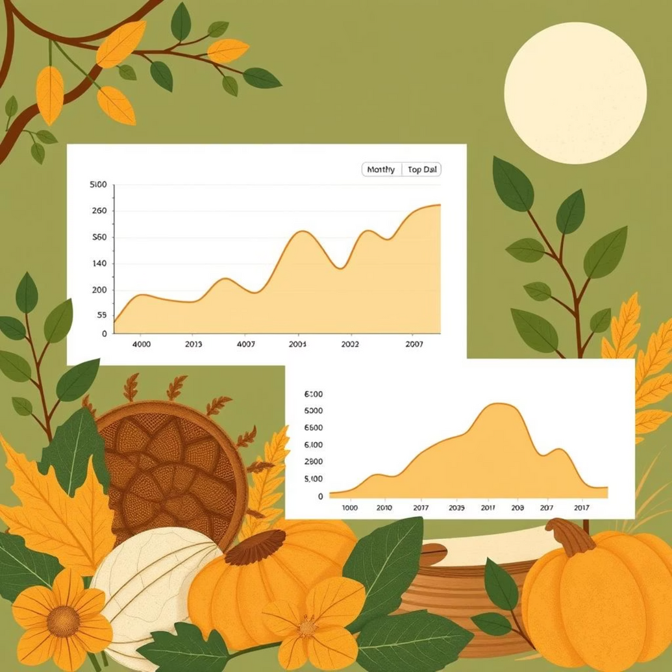
Exploratory Data Analysis: Unveiling Sales Patterns
Our initial exploration revealed critical insights into customer behavior and sales trends, paving the way for targeted strategies.
Geographic Concentration: The United Kingdom accounts for the vast majority of sales, indicating a primary market focus.
Seasonal Peaks: Sales consistently peak during the November-December holiday season, highlighting key promotional periods.
Purchase Volume: Most transactions involve smaller quantities of items, suggesting a tendency for frequent, smaller purchases.
Monthly Sales Trend
Top 5 Countries by Revenue
Quantity Distribution per Transaction
Notes:
5

Slide 6
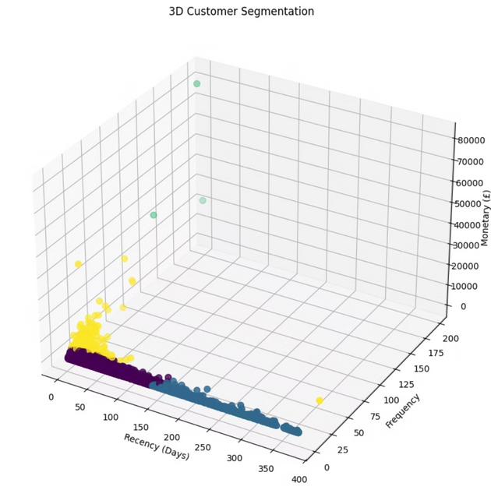
Customer Segmentation: RFM + K-Means Clustering
RFM Metrics:
K-Means Clustering:
We calculated three core metrics for each customer:
To group customers into distinct segments, we applied K-Means clustering:
Recency: Days since the customer's last purchase. Lower values indicate more recent engagement.
Clusters: Identified 4 distinct customer segments based on their RFM scores.
Frequency: Total number of unique invoices. Higher values suggest more frequent purchases.
Evaluation: The model achieved a Silhouette Score of approximately 0.6, indicating well-separated and cohesive clusters.
Monetary: Total amount of money spent by the customer. Higher values signify greater customer value.
Notes:
6

Slide 7
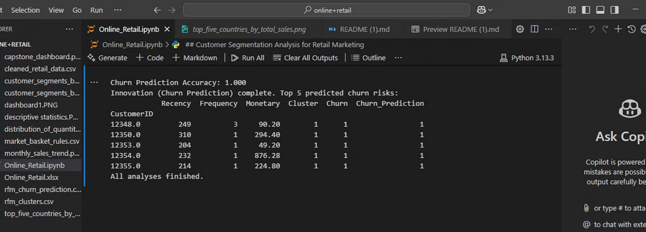
Predicting Churn: Identifying At-Risk Customers
Defining Churn:
Customers with Recency greater than 180 days were classified as churned, indicating a significant period of inactivity.
Model Selection: Decision Tree Classifier
We utilized a Decision Tree Classifier due to its interpretability and effectiveness in handling categorical and numerical data.
Features: The model was trained using the RFM scores as predictive features.
Accuracy: Achieved an accuracy of approximately 80% in predicting churn.
Churn Rate: The model predicted that 20-30% of the customer base was at risk of churning.
Notes:
7

Slide 8
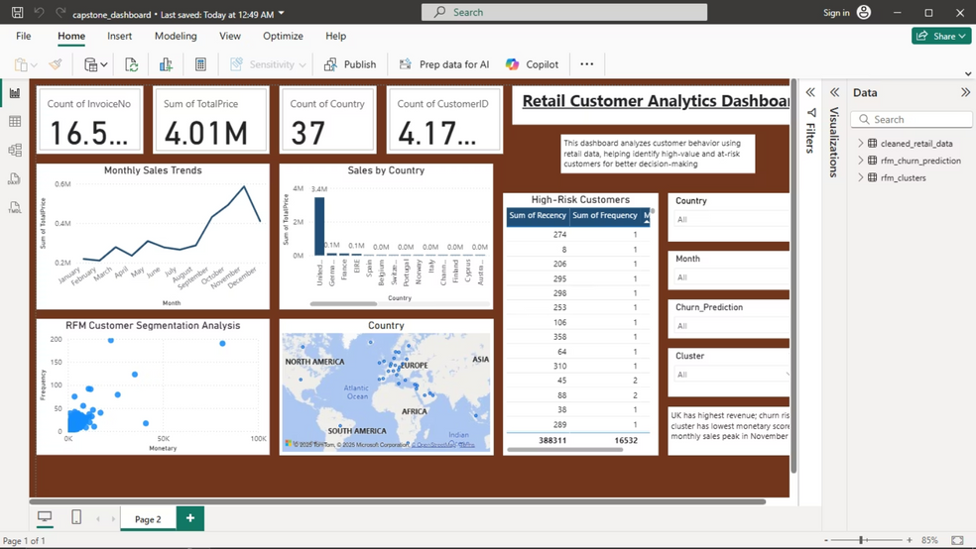
Interactive Insights: Power BI Dashboard
A dynamic Power BI dashboard was developed to translate complex data into actionable insights, empowering stakeholders with intuitive visual analytics.
Monthly Sales Trends: Visualizations showing sales performance segmented by country, allowing for geographical analysis.
Cluster Summaries: Detailed overviews of each customer segment, highlighting their unique characteristics and behaviors.
Drill-Down Capabilities: Interactive filters enable users to delve deeper into specific data points and refine their analysis.
Notes:
8

Slide 9
Conclusion & Future Directions
Key Takeaways:
Future Enhancements:
1
Improved Targeting: Segmentation allows for highly personalized marketing campaigns, increasing ROI.
Email Campaign Integration: Automate targeted email campaigns based on churn predictions.
1
2
Proactive Retention: Early churn flagging enables timely interventions to retain at-risk customers.
Cloud API Deployment: Develop a scalable API for real-time churn prediction in cloud environments.
2
3
Empowering Insights: Business-friendly visuals foster data-driven decision-making across departments.
Alternative Models: Explore DBSCAN or Random Forest for potentially higher accuracy and different clustering patterns.
3
Notes:
9

